Slide 1
Rapidly-exploring Random Tree Star
Motion Planning Algorithm and Path Planning Method
References:
Jinshan Song, Satyandra K. Gupta, and Thomas A. Wettergren "MRRT: Multiple Rapidly-Exploring Random Trees for Fast Online Replanning in Dynamic Environments" 2023, DOI: 10.48550/arXiv.2104.11059
James J. Kuffner and Steven M. LaValle "RRT-Connect: An Efficient Approach to Single-Query Path Planning" 2000, DOI: 10.1109/ICRA.2000.844730

Slide 2
Overview
Rapidly-exploring Random Tree star (RRT*) by optimizing the generated tree structure to find more efficient paths. RRT continuously reevaluates and optimizes the tree by rewiring connections and adjusting node costs based on new information, aiming to minimize path length and improve feasibility within a given environment. This approach makes RRT* particularly effective for dynamic or complex environments where real-time path adaptation and optimization are crucial.

Slide 3
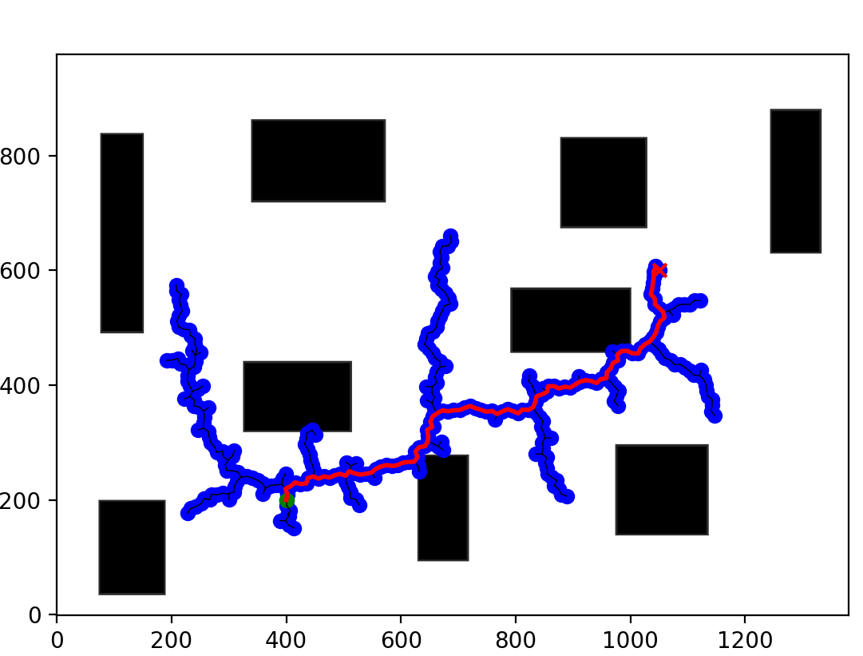
Random tree’s Connections
RRT* (Rapidly-exploring Random Tree Star) path planning works by iteratively expanding a tree structure from an initial configuration towards the goal configuration in a probabilistically guided manner.

Slide 4
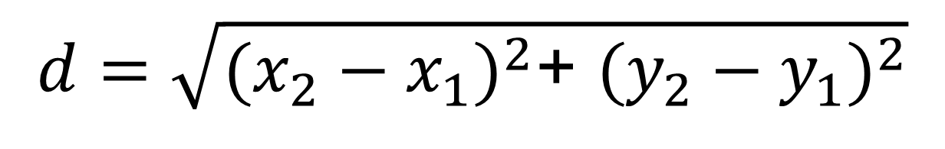
Euclidean’s Distance Algorithm
The Euclidean distance algorithm is a formula used to calculate the distance between two points in space. The formula depends on the dimensionality of the space
$$d=\sqrt{{(x_{2}−x_{1})}^{2}​\text{+ }{(y_{2}−y_{1})}^{2}}$$

Slide 5
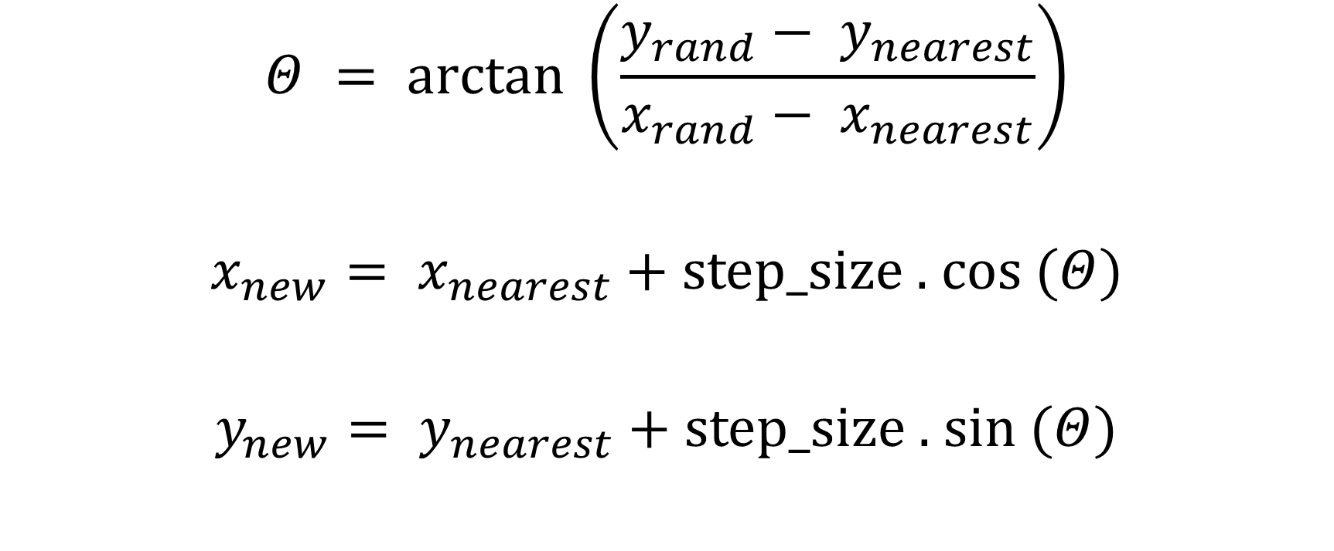
Trigonometry to calculate new coordinates
$$Θ = arctan ⁡\left(\frac{y_{rand}− y_{nearest}}{x_{rand}− x_{nearest}}\right)$$
$x_{new}= x_{nearest}+$ step_size . cos ($Θ$)
$y_{new}= y_{nearest}+$ step_size . sin ($Θ$)

Slide 6
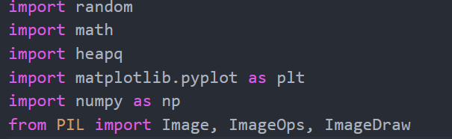
Code Explanation
Using PyPi such as:
Random: Python’s build-in library for generating random numbers and sequences.
Math: Python’s build in library providing mathematical functions and constants.
Heapq: Python’s build in library for heap queue algorithm implementations, used here for priority queue fungtionalities.
Mathplotlib: A plotting library for creating static, animated and interactive visualizations in python.
Numpy: Numerical computing in python.
PIL (Python Imaging Library): Opening, manipulating, and saving many different image file

Slide 7
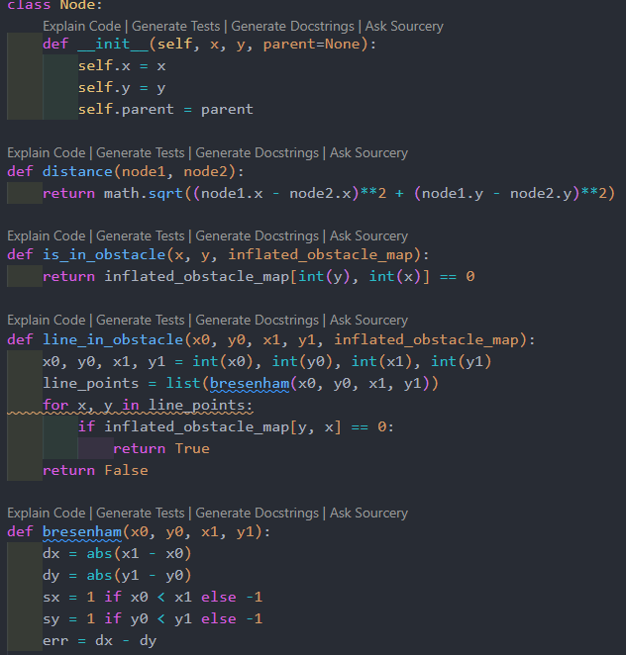
Node Class & Distance Function:
Class Node represents points in 2D space with coordinates (x, y) and a parent node for tree structure. distance function computes Euclidean distance between two nodes, essential for measuring distances in path planning.
Obstacle Handling Functions:
is_in_obstacle checks if a point is within an obstacle using an inflated obstacle map. line_in_obstacle uses Bresenham's algorithm to detect if a straight line between two points intersects with obstacles on an inflated map, crucial for validating potential paths in grid-based environments.
These functions, integrated into path planning algorithms like RRT, provide foundational support for node representation, distance calculation, and obstacle detection necessary for generating feasible paths in complex environments.

Slide 8
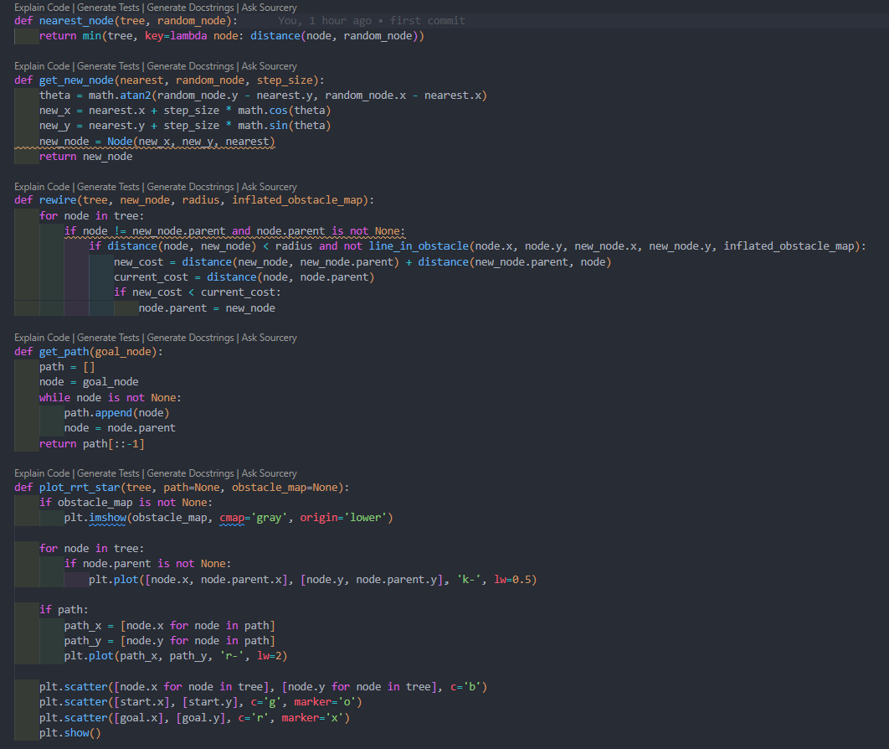
nearest_node Function: Finds the nearest node in a tree (tree) to a given random node (random_node) based on Euclidean distance using Python's min function with a lambda expression.
get_new_node Function: Generates a new node (new_node) from a nearest node (nearest) towards a random node (random_node) by a specified step size (step_size). Calculates new coordinates based on the direction angle (theta) computed using math.atan2.
rewire Function: Updates the parent-child relationships in the tree (tree) to potentially optimize paths. Checks if connecting new_node to an existing node (node) reduces the path cost (new_cost) compared to the current cost (current_cost). Uses obstacle checking (line_in_obstacle) and distance calculations.
get_path Function: Constructs a path from a goal node (goal_node) back to the start node (None) by tracing through parent links. Returns the path in reverse order.
plot_rrt_star Function: Visualizes the RRT* algorithm's progress and resulting path using Matplotlib. Plots nodes (tree) in blue, connections in black, and final path (path) in red. Can overlay an obstacle map (obstacle_map) if provided.
These functions collectively implement core functionalities of the RRT* path planning algorithm, enabling node manipulation, path optimization, and visualization in grid-based environments with obstacles.

Slide 9
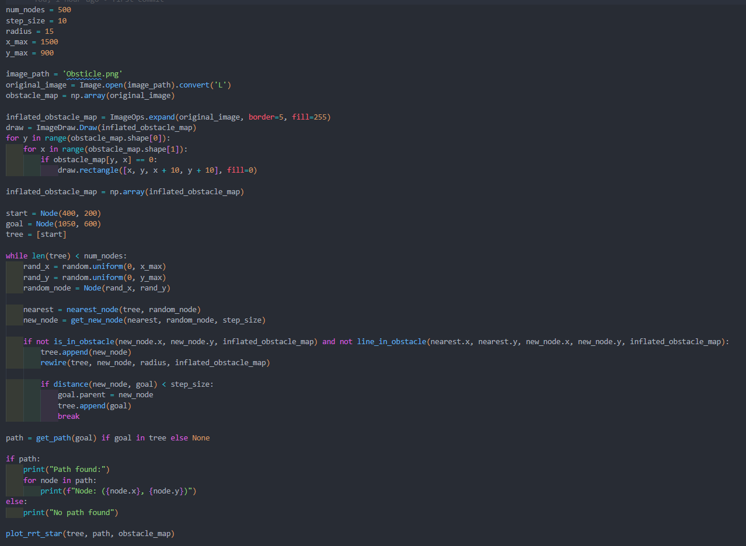
Setup: Initializes parameters like num_nodes, step_size, radius, x_max, y_max, and loads an obstacle map (Obsticle.png) converted to grayscale (original_image) and represented as a numpy array (obstacle_map).
Obstacle Inflation: Expands the obstacle map (original_image) using ImageOps.expand and draws rectangles around obstacle pixels to create an inflated obstacle map (inflated_obstacle_map).
Start and Goal Nodes: Defines start (start) and goal (goal) nodes with specific coordinates (e.g., (400, 200) for start and (1050, 600) for goal).
RRT Algorithm Execution*: Iteratively generates random nodes and expands the tree (tree) towards these nodes until reaching num_nodes. Uses functions nearest_node to find the nearest node in tree, get_new_node to create a new node towards the random node, and rewire to optimize node connections based on path costs and obstacle checks.Terminates early if the distance between a new node and the goal (goal) is less than step_size.
Path Finding: Constructs a path (path) from the goal node (goal) back to the start node (start) using get_path if a path exists in the tree (tree).
Visualization: Prints the found path nodes if path exists; otherwise, prints no path found. Visualizes the tree (tree), path (path), and obstacle map (obstacle_map) using plot_rrt_star.
This script combines path planning algorithms with obstacle handling and visualization, crucial for navigating complex environments in robotics applications.

Slide 10

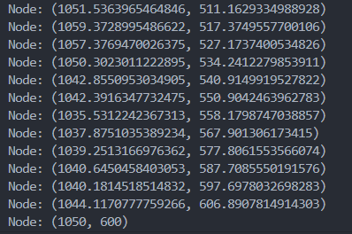
Output Representation
Original .PNG
Rapidly-exploring Random Tree

